Slide 1
Object Oriented Programming Lecture - 30
Prof. Varsha Dange

Slide 2
Multithreading
Multithreading is a Java feature that allows concurrent execution of two or more parts of a program for maximum utilization of CPU.
Each part of such program is called a thread.
So, threads are light-weight processes within a process.
when an executable program is loaded into memory, it is called process.
Every individual process has its own separate memory address space and can execute a different program.
2. Each process can have more than one thread.
3. Each process communicates through the operating system, files, and network.

Slide 3
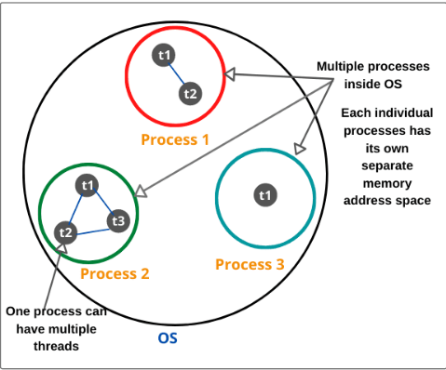
Multithreading
When we will create a new thread in a program, it shares the same memory address space with other threads in a program

Slide 4
Why Java threads are lightweight process?
Java Threads are also known as lightweight threads or light-weight processes.
It means that they can be executed in the same memory space because all the threads in the main application program share the same address space in the memory so that they can easily communicate among themselves.
Thus, they also take less space in memory and less processor time.

Slide 5
Main Thread in Java
Every Java program has always at least one thread, even if you do not create any thread.
This thread is called main thread.
The main thread is also called parent thread and
the rest of threads that are generated from it are called child threads of the program.

Slide 6
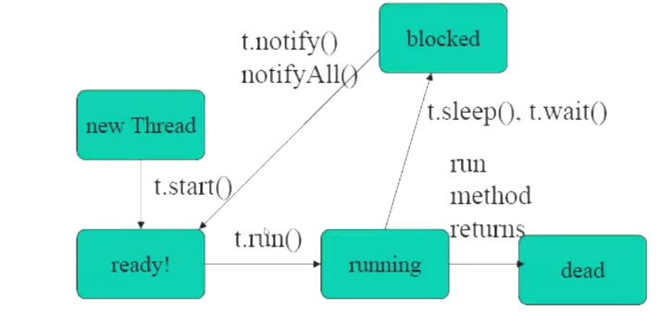
Thread Life Cycle

Slide 7
Use of Thread in Java
threads can be used to perform more than one task simultaneously.
Threads are mainly used in server-side programs where we need to handle multiple clients on network or internet simultaneously.
in creating games and animations.

Slide 8
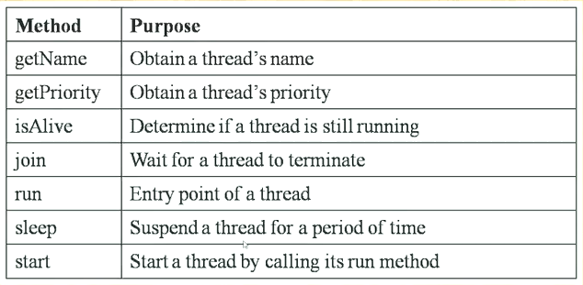
Thread Methods in Java

Slide 9
Thread Methods in Java
Method | Description
currentThread() | returns the reference of currently executing thread.
setName() | used to set the name of a thread.
yield() | pauses the execution of current thread and allows another thread of equal or higher priority that are waiting to execute.
activeCount() | returns the number of active threads.
setPriority() | used to set the priority of a thread
suspend() | is used to suspend or pause a thread.
resume() | used to resume the suspended thread

Slide 10
Creating Thread in Java
two ways to create a new thread in Java.
1. One is by extending java.lang.Thread class 2. Another is by implementing java.lang.Runnable interface

Slide 11
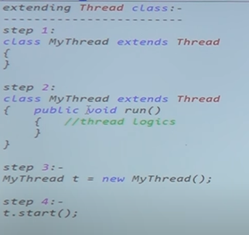
Extending Thread class in Java

Slide 12
Extending Thread Class in Java
We create a class that extends the java.lang.Thread class.
This class overrides the run() method available in the Thread class.
Create an object of newly created class so that run() method is available for execution.
We create an object of our new class and call start() method to start the execution of a thread.
Start() invokes the run() method on the Thread object.
Example1
Example2

Slide 13
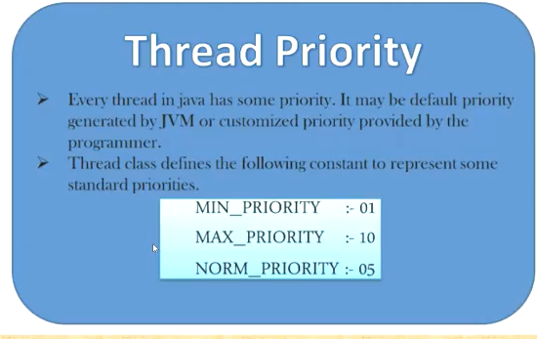
Thread Priority in Java

Slide 14
Daemon Thread in Java
Thread which runs in background to support foreground threads. Ex-
Garbage collector
Default exception handler
Thread scheduler
setDaemon (boolean value)

Slide 15
Synchronization in Java
more than one thread access the common resource (shared resource). That is, more than one thread access the same object of a class.
But preventing any other thread from acting on the same object is called ‘thread synchronization in Java‘ or ‘ Thread safe‘.
Java provides a keyword named “synchronized” that helps to synchronize thread.
The synchronization is mainly used to prevent thread interference and consistency problem.

Slide 16
Synchronization in Java
There are two ways by which we can achieve or implement synchronization in Java. That is, we can synchronize the object. They are:
1. Synchronized Method 2. Synchronized Block

Slide 17
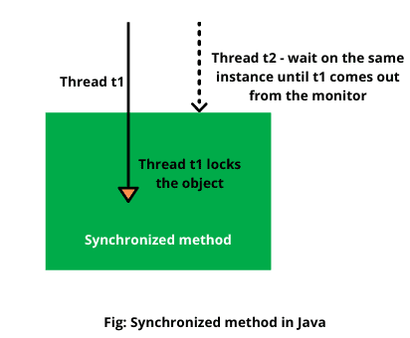
Synchronization in Java
synchronized method in Java declare with synchronized keyword
When a method is declared as synchronized, JVM creates a monitor (lock).
The thread that calls the synchronized method first, acquires object lock.
If the object lock is not available, the calling thread is blocked and it has to wait until the lock becomes available.

Slide 18
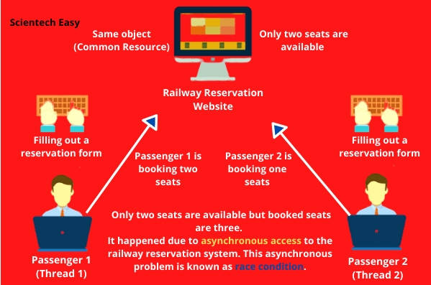
Synchronization in Java
The solution to this problem can be solved by a synchronization mechanism in which when one thread is accessing the state of object, another thread will wait to access the same object at a time until their come turn.

Slide 19
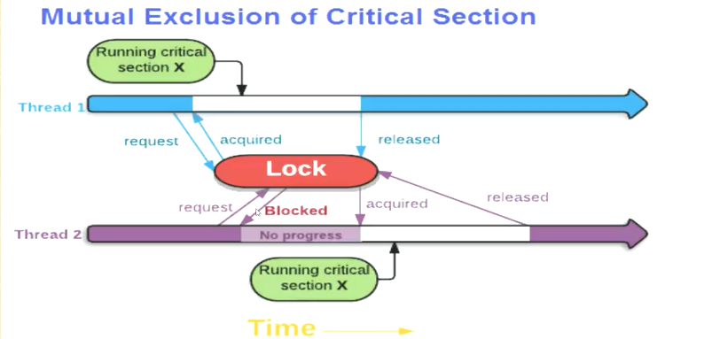
Synchronization in Java

Slide 20
Synchronization in Java
Can we synchronize static method in Java?
Yes, a static method can also be synchronized.
In this case, the lock is placed on the class, not on the object.
The thread will execute the method body only when the lock is placed on the class.
It will hold the lock until it leaves the method body. This is called static synchronization in java.

Slide 21
Inter Thread Communication in Java
Inter-thread communication in Java is a technique through which multiple threads communicate with each other.
During execution threads need to communicate with each other by exchanging information with each other.
A thread exchanges information before or after it changes its state.
Inter thread communication in Java can be achieved by using three methods provided by Object class of java.lang package.
They are:
1. wait() 2. notify() 3. notifyAll()

Slide 22
Inter Thread Communication in Java
wait() method in Java notifies the current thread to stop the execution and go into sleep state until another thread wakes it up by calling notify() method
The notify() method wakes up a single thread that called wait() method
The notifyAll() method is used to wake up all threads that called wait() method. The thread having the highest priority will run first.

Slide 23
Deadlock in Java
when more than one threads are used in a program, they share resources.
At a time, a particular resource is allotted to a thread that gains object lock for that resource.
Deadlock in Java is a situation that occurs when a thread is waiting for an object lock, that is acquired by another thread, and second thread is waiting for an object lock that is acquired by the first thread.
Since both threads are waiting for each other to release the lock simultaneously, this condition is called deadlock in Java.
The object locks acquired by both threads are not released until their execution is not completed.

